Slide 1
Sunny Inc
Presented by: Zsombor Hajzer, Yohan Lozanov and Beyza Ölmez

Slide 2
Who are we?
Zsombor Hajzer (Team Leader)
Yohan Lozanov (Technical Advisor)
Alikhan Smagulov (Secretary)
Maksym Bivol (Team Member)
Beyza Ölmez (Team Member)
Rares Manoli(Team Member)
Team H

Slide 3
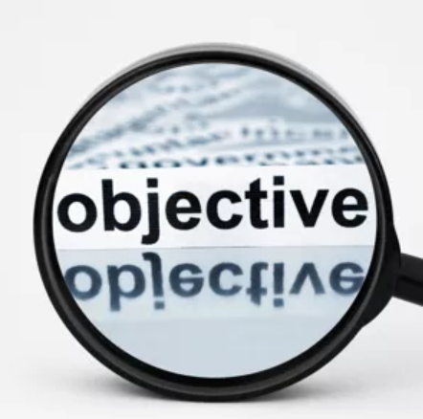
What was the aim of this project?
Create a functional website
Create multiple design interpretations for client
Use of usability test feedback
Client needs, wants and further specifications
Younger audience
Follow brand book
Functionalities (e.g. newsletter, random fact in webshop)
Mobile functional
Dynamic website design

Slide 4
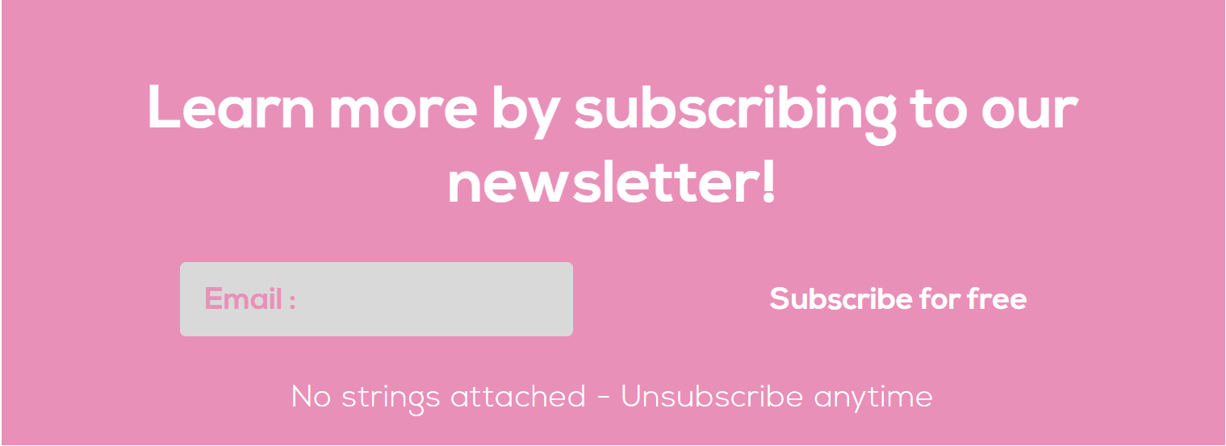
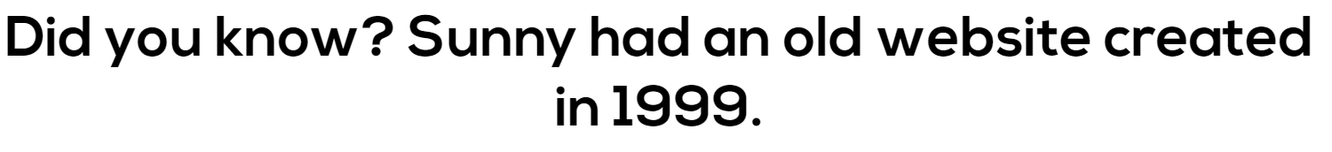
Preconditions and Requirements
Parts of the website:
Home page
About us section
Products page
Webshop page
Contact page
Website functionalities
Newsletter
Dynamic web design
Mobile web design
Random facts in webshop
Interactive header

Slide 5
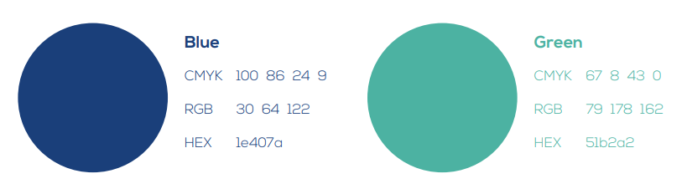
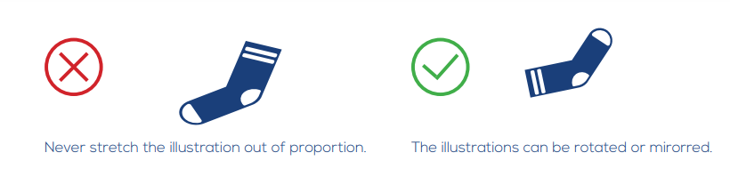
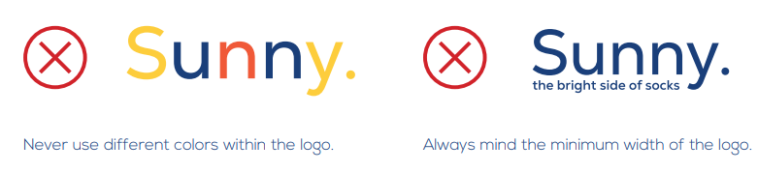
Preconditions and Requirements:
Brand Book Limitations
Nexa Bold or Light only
Logo specifications
Color specification
Image specification
Mission and Vision unchanged

Slide 6
Challenging Design
How the specifications were incorporated and eventually culminated.
“Younger audience”, maximizing functionality

Slide 7
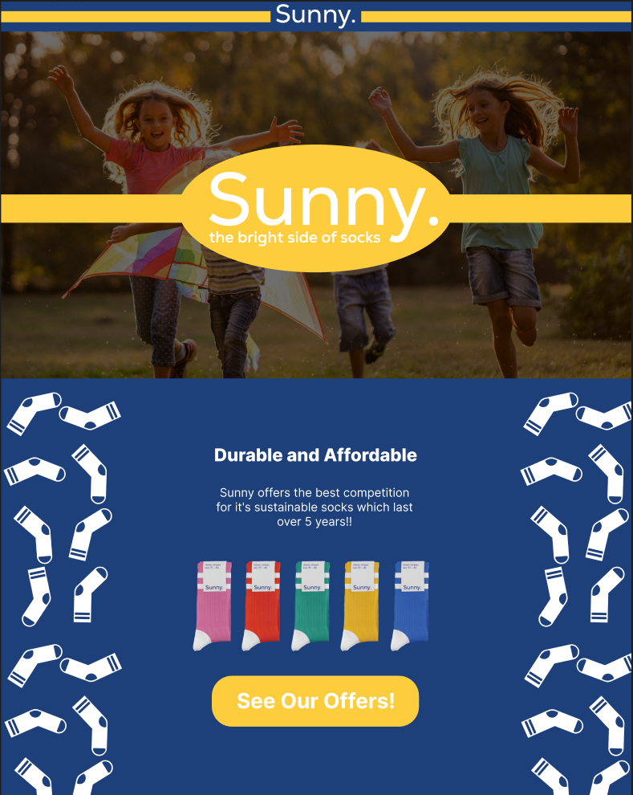
“Younger audience”
Targets parents, childlike appeal.
Doesn’t appeal to everyone.
Not maneuverable.
Raise demographic.

Slide 8
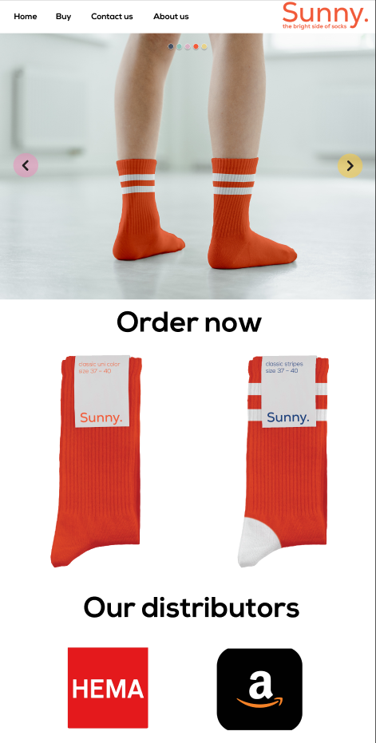
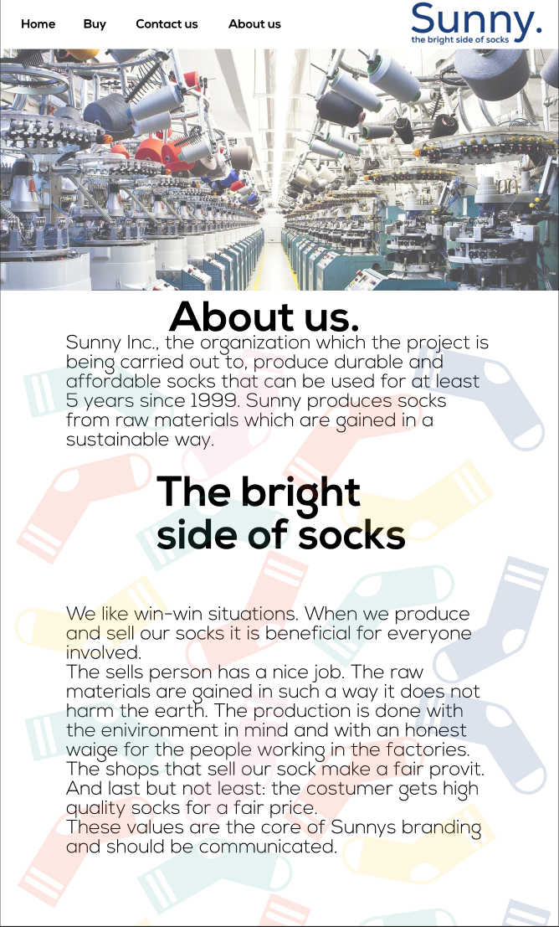
Functionality
Doesn’t aim to just meet requirements.
Easy to navigate - header.
Its selling point.
Design choice issues.

Slide 9
The final design
Learns from the first
Aesthetically pleasing
High regard for visual hierarchy
Adapts from the second
Familiar
Navigability and accessibility
Sock showcase functionality

Slide 10

Please sit back and enjoy the tour of our website

Slide 11
To conclude the design
Solutions:
Target an E audience
⮴ Accessibility
Ideas:
Color changing sock showcase
Making use of letter spacing
Why it became this product:
Wide audience
Remain simple

Slide 12

Thank you for listening!

